Slide 1
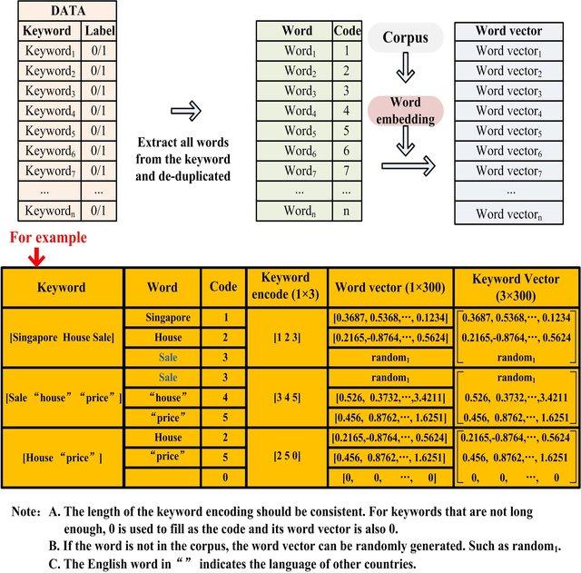
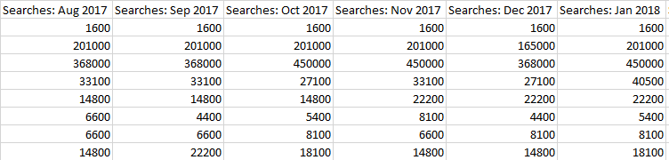
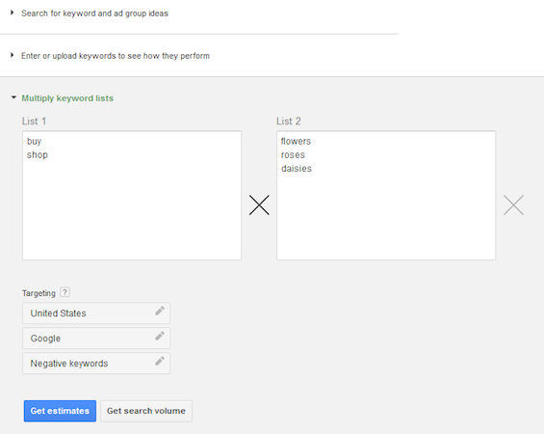
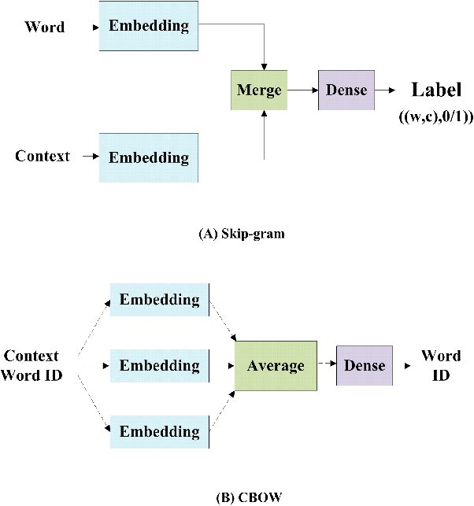
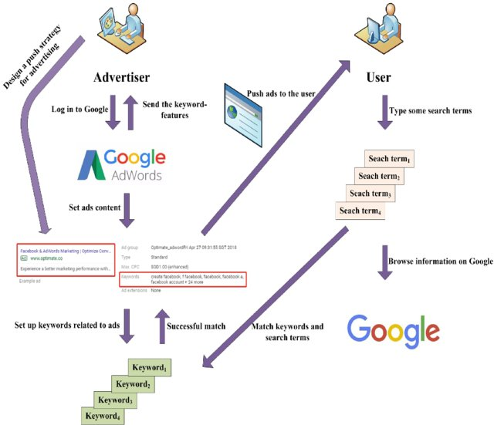
Course: ITE 367 Instructor: Dr. Surekha Lanka Student: Fardina Kabir 1910080005
Final Presentation 10/10/2022
Project Title: Google's tool for Keyword Planning
5.5. Sequence diagram : WORD EMBEDDING: By using word embedding, we may transform individual words into vectors
Task 5_Analysis and Design:
5.1. Functional requirements: A breakdown of the 4 functional requirements for the tool :
Type 1: Concepts for ad categories & keyword searches.
Type 2: Test the Efficiency of Keywords Users Provide
Type 3: multiply lists of keywords.
Type 4: Local Targeting.
5.2. Non- Functional requirements:
The tool is good in terms of physical appearance
& acceleration
A more rapid download time.
The Role of Other Ranking Factors
The Performance of Google's Ads Planner.
The flow/process through which keywords are transformed into vectors using corpus to address the issue of having many languages present in the same data set.
Fig: e.g. The time report's monthly searches are broken down by month.
5.4. Design diagram:
The work process of Google Ads is divided into 5 measures:
advertiser sets the content of the ad by their needs.
advertiser selects keywords on system by ad content.
set keywords are matched with terms searched by the user in the search engine.
Google Ads sends the keywords-features to the advertiser when the keywords are input into the Google Ads.
If these keywords are not ‘good’, they will be removed by advertisers from Google Ads.
E.g Figure: Multiplying Keyword lists in the keyword Planner
5.3. Use case requirements :
Four criteria should be met by the keywords users choose to focus on: 1)substantial search traffic 2) high relevance 3) good conversion value and 4) moderate competition.
Both skip-gram & CBOW Word2Vec models.
Ads by Google's process flow design diagram

Slide 2
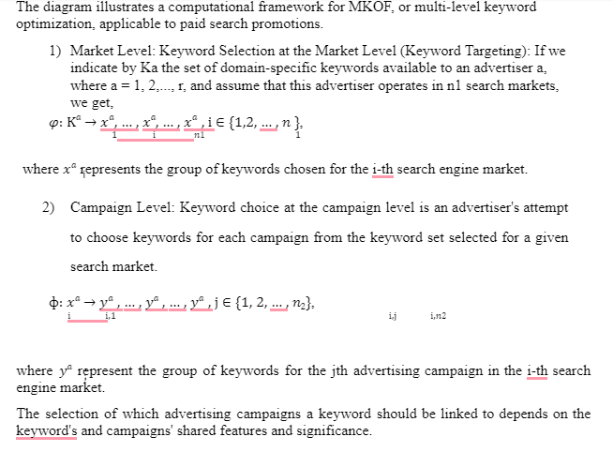
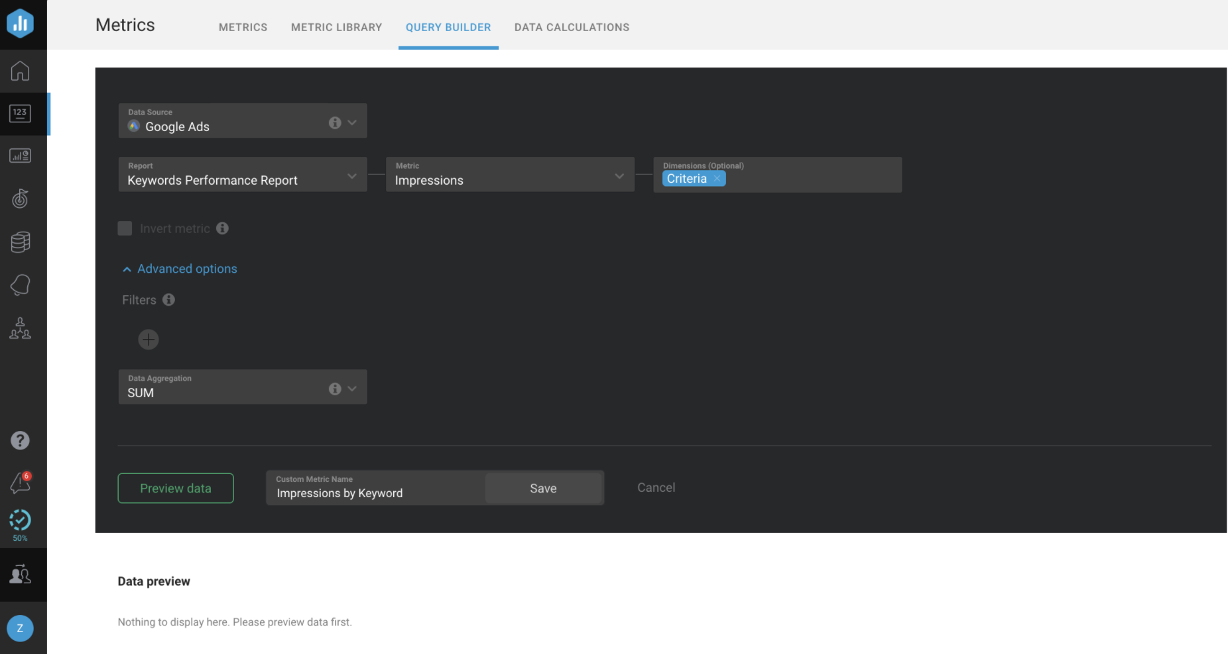
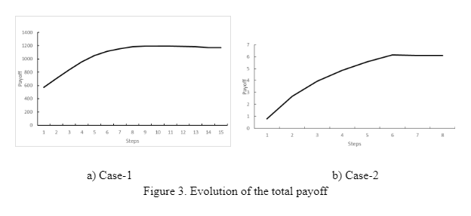
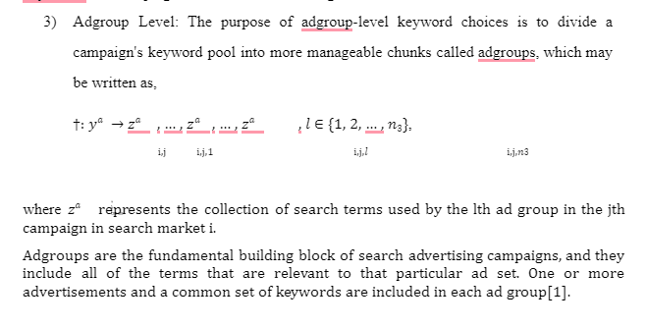
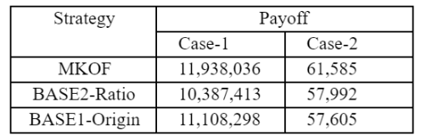
Task 6 : 6.1. Use-Case view: Formalizing Reports on Keyword Success/Failure.
Data on "Impressions," "Cost per Conversion," "Average CPC," or similar metrics viewed for a single Keyword or a set of Keywords. Reporting on the success of a Keyword/ Keywords set is possible using Basic/Custom Metrics.
6.1.1. Use-Case Realizations:
I. formulate Alternatives
6.1.1. Use-Case Realizations:
III. Make Decision
In both circumstances, our MKOF technique generates a total payout that grows slowly over the course of each iteration and converges to a near-optimal value in a limited number of iterations.
This observation lends credence to the claim that our MKOF approach is capable of rapid convergence, yielding a list of keywords that strikes a good balance between total relevance and total profit at the near-optimal level.
6.1.1. Use-Case Realizations:
II. Evaluate Alternatives
To prove the efficacy of our approach, we compare two reference strategies to our own keyword optimization framework (MKOF) and its instantiation strategies. For the sake of analysis, we deployed two control techniques :
The BASE1-Origin strategy represents the company's historical advertising approach.
In order to help marketers optimize advertising efficiency, BASE2-Ratio uses a well-established heuristic (the click-through-rate to cost-per-click ratio) since CTR is a significant aspect in determining the quality score for sponsored search ads.
Better quality might mean more clicks at reduced prices.
Since our technique and BASE1-Origin share a same set of target keywords, a comparison between the two allows us to gauge the efficacy of our keyword assignment and grouping methods.
In Case 1, we have three keywords pertaining to the company name, while in Case 2, we have two keywords pertaining to the major product. Our MKOF and two baseline methods are compared in Table 1.
In conclusion, the experimental findings support our suggested computational framework as a practical answer to the problem of keyword choices in sponsored search advertising. Comparing its overall return to that of two control techniques, it clearly performs better.
The experimental findings reveal that our strategy consistently beats two baseline methods in terms of total payout, suggesting that it can reliably approximate the optimum solution.
II. Evaluate Alternatives :
Table 1: Comparison between the MKOF and two control techniques.

Slide 3
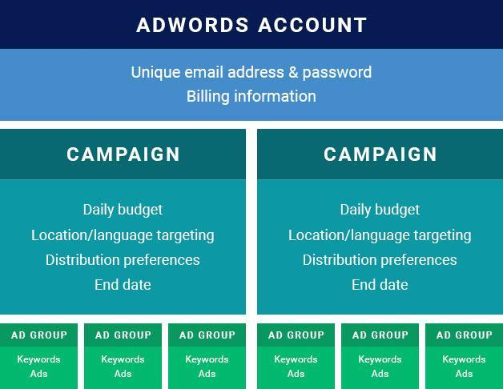
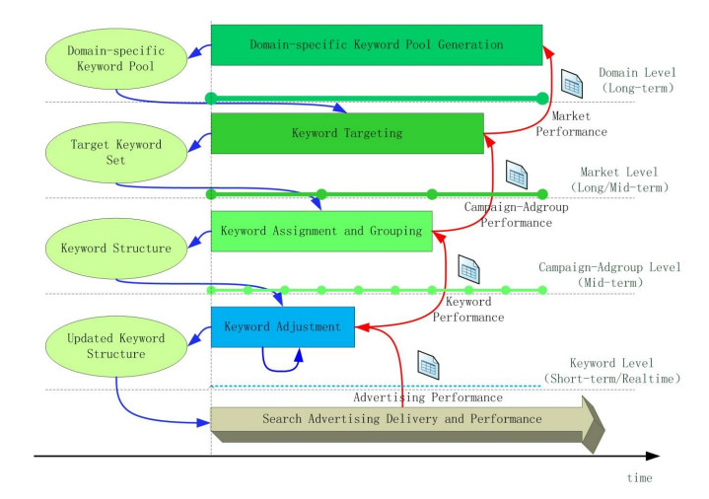
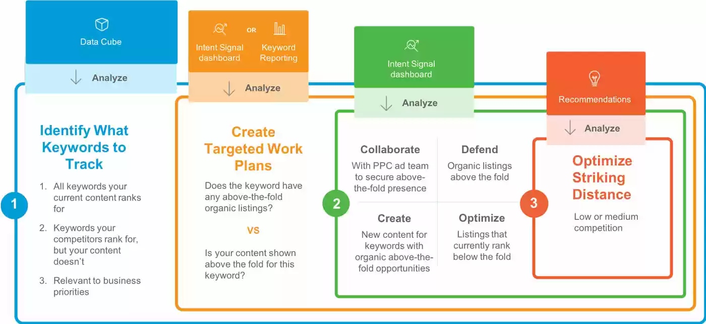
6.2. Design View:
The sponsored search advertising lifecycle is punctuated by decision points for AdWords keywords. There are 3 distinct circumstances when choosing keywords:
1) Domain-specific keyword pool generation
2) Keyword targeting (the Market-level Keyword Optimization)
3) Categorizing and assigning keywords (optimizing at the campaign and ad group levels) using Keyword Grouping, & Keyword Assignment.
6.3. Component View: Overview of Google Ads Account Structure & Setup
At the account level, advertisers change things like payment details and time zone.
Each profile has conducted specific campaigns. Using email address & password, advertiser create Google Ads account. Thus, signing up for Google Ad account is easy.
It is required that this email address be associated with a Google account (registered on Gmail). Use this login for access to all Google services, including Ads.
After account created, advertiser provide their billing information & choose a time zone.
6.4. Deployment View :
The search engine results page (SERP) is customized to display a variety of content kinds above organic web listings.
The SEO keyword target list has to be updated on a regular basis, with a primary emphasis placed on terms that have the most potential upside.
Utilize GKP for a comprehensive solution whether users are building an initial set of SEO keyword lists or listrevising the high-value keyword .
Keyword decisions in sponsored search advertising
There is a recursive decision-making process based on keyword selection in sponsored search advertising
i.e. the outcomes of higher-level choices serve as inputs for subsequent, lower-level decisions, & the outcomes of lower-level operations serve as feedback for higher-level decisions.
Therefore, it is important to provide a unified computational framework to help marketers optimize their term selections across all of their sponsored search campaigns[1].

Slide 4
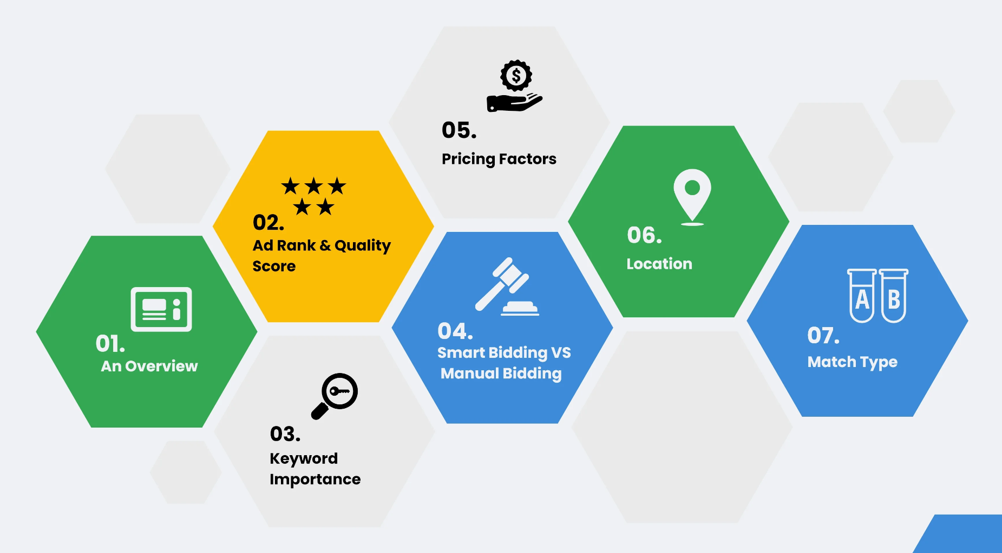
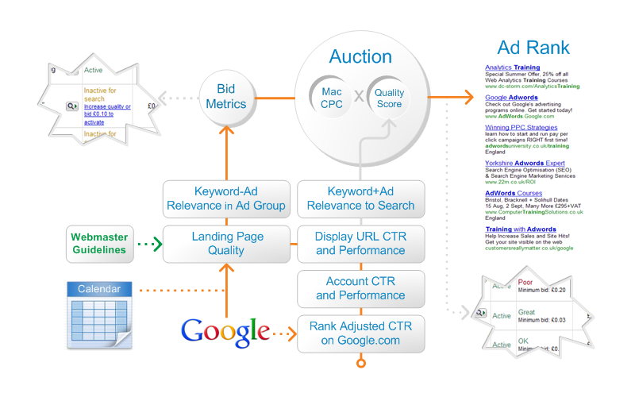
Project Task 7: Implementation View
Ad Rank & Quality Score:
The Ad Rank value depends on two factors: Quality score of user ad states their overall ad quality ( keywords, landing pages) and the relevance of their ad.
User Ad’s Quality Score depends on: Relevant Landing Pages, Click-Through-Ratio Expectations & How Relevant is user Ad
Keyword Importance: Keyword bidding by Google Ads.
Manual Bidding: Google Ads experts control their keyword bidding using Google Ads & make judgments without the use of machine learning. The Manual Bidding Process should be used when they are on a tight budget.
Smart Bidding: The Smart Bidding keyword approach,employs algorithms for bid optimization along with goals & features of user PPC campaign.
Pricing Factors: Everything is determined by user campaign type, goals, budget, & set of targeted keywords. In order for the targeted keywords to display on their Google AD, they must bid using the auction model after choosing their campaign goals, specifying their budget, and doing so.
Location: Users must choose a specific area for their advertisements to appear after setting up their Google AdWords account. Google will only show its advertisements in the places they choose.
Keyword Match Type: The keyword match types users choose for their advertisements inform Google what to match them with. It informs Google whether users like their advertisements to precisely match a search query or whether they want them to be seen by anybody who enters a semi-related search query.
Implementation Layers:
Ad Rank & Quality Score.
Keyword Importance.
Manual Bidding & Automated Bidding.
Pricing Factors
Location
Keyword Match Type
In conclusion, creating successful campaigns requires an understanding of the underlying principles of AdWords.
We described the Google results page, Quality Score, the AdWords auction, and Latent Semantic Indexing (including features like Instant and the integration of Google+ into their SERPs) (LSI).
Knowing how Google's platform functions will help users skip the costly learning curve that new advertisers must go through & will help their company dominate Google's results page as well.
Key concepts for utilising Google Keyword planning tool and its implementation in google ads
Tool overview in Google ads:
Users will be sent to a page with many pertinent search results if they Google "purchase smartphone online.".
The word ADS will be written on top of the search result that is shown at the top of the SERP.
That is a Google advertisement that always appears as the top SERP result.
We look at the many elements that go into selecting high-quality Google Ads to make users’ Google Ads appear first in the SERPs[1].

Slide 5
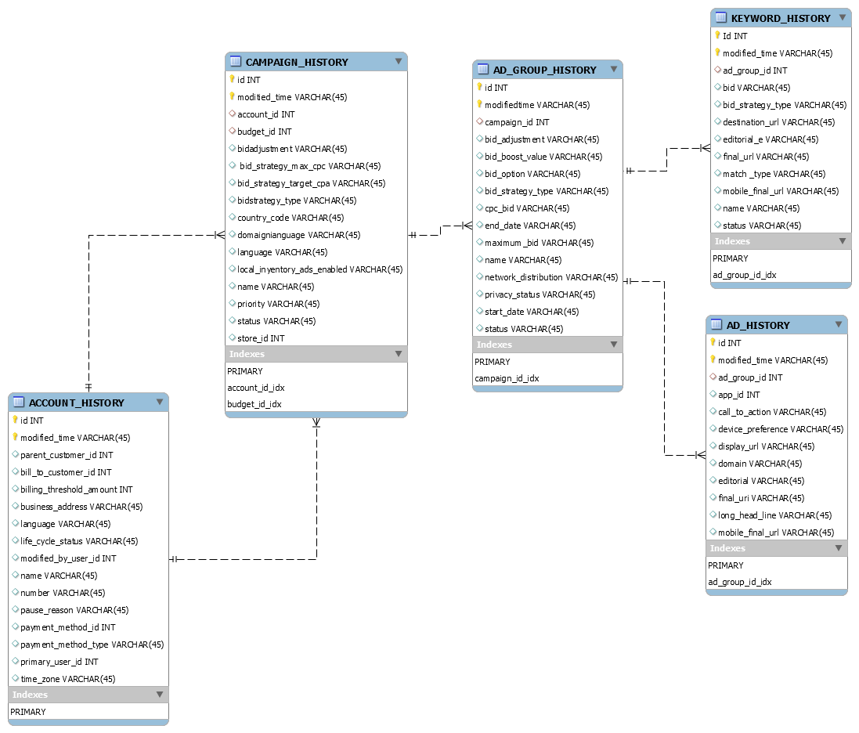
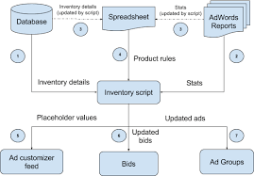
Task 8: Data View
ER-model of data stored in a relational
daaataatabase:
How it works
The key interactions between the script and the various components:
With keyword results, the Google AdWords Keyword
Tool offers a number of statistics.
We choose the terms that are likely to provide high-quality leads within user budget using this data.
Here is each category of statistics[2]:
Projected Ad Position
Estimated Average CPC
Competition from Advertisers
Local Search Volume [Last Available Month]
Global Monthly Search Volume
Search Volume Trends
Highest Volume Occurred In a number of month
Functionality: Logically, there are 2 types
of AdWords API web services[2].
• Campaign Data Services: Uses these online services to manage campaigns, ad groups, criteria, and other
• Utility Services: Manages user AdWords accounts and help adjust their advertisements wisely by using these online services
The script begins by extracting statistics from Google Ads reports & inventory info from the database.
Then uploads these numbers to the spreadsheet to check for any product codes that match.
The calculations in the spreadsheet are edited as a result, & the product rules are revised.
The script then adjusts the advertising & bids by the revised product regulations after downloading them from the spreadsheet.
Thus, the advertisements are delivered with the most recent values, the ad customizer feed is updated with the most recent placeholder values from the database and spreadsheet.
Inventory-based Ad Management:
Users that promote many items online need to regularly carry out the ad management chores regularly to keep their advertising approach by their sales and marketing plan.
Some of these procedures typically take a long time to do manually.
Users can automate some of these operations with the use of the inventory-based ad management script[3].

Slide 6
Data View: Accessing the database to retrieve stock information.
By connecting to a SQL database on a user server or a Google Cloud SQL database, the inventory-based ad management script gets the inventory data for your items.
After then, this information is kept in a Google Spreadsheet. Data from the database and rows in the Google spreadsheet are matched using the product code.
Task 9_A Expected Test Case Scenario:
Test Scenario | Test Steps | Expected results
Consider new keyword | Under "Planning," of Google ads acc click the setting button, & select Keyword Planner. Click Find fresh keyword ideas. There are three techniques to find fresh keyword suggestions: Begin with keyword Enter the user domain, & Google filters terms unrelated to user's offering. Begin with a website Preview keyword suggestions in ad groups 4. Select Get results by clicking it. | Get keyword ideas for user products, services, or websites.
Data View: Script capabilities
The following functions can be carried out by the inventory-based ad management script:
Get information about your inventory stock from a distant database or a Google Cloud SQL database and enter it into a Google spreadsheet.
Fill the Google spreadsheet with statistics from various product reports.
9.2 Unit Test
The client library used for this document allows it to obtain Google Ads campaigns. Getting the necessary OAuth2 credentials is the first step in enabling API access. Add the authorization and account information after that to a configuration file. When the configuration file is finished, the user is prepared to utilize the API to begin keyword research for their companies, organizations, or other relevant terms.

Slide 7
Task 9_Database model: Gaining entry to the database to get stock information
The inventory-based ad management script gets the inventory information for user goods by making a connection to a SQL database on a user server or a Google Cloud SQL database.
After that, a Google Spreadsheet is used to store this data. The product code is used to link rows in the Google spreadsheet with data from the database.
FUNCTIONAL TEST CASES
Sr No. | Test Scenario | Test Steps | Expected results
1 | Enter a word in the search text box | 1. Launch https://www.google.com from any web browser. 2. Enter the text ‘Apple’ in the search text box. 3. Click the Search button | 1. On clicking the search button, it should redirect user to search results. 2. Search results should be relevant.
2 | Max length of search keyword | 1. Launch https://www.google.com from any web browser. 2. Enter text ‘Waterproof smart watches ’ in the search text box. 3. Press the Enter key | 1. On pressing the Enter key, it should redirect the user to search results. 2. Search results should be relevant.
The script assumes that the database has a table named items with the following schema for convenience's sake:
Function name | Inputs | Expected outputs /resulting outputs
add code | string | The specific item code is true or false depending on matching from user input
Add stock | number | Information on the availability of this item in the inventory is kept on the data server.
The script runs the query on the remote database and inputs the results into the Stats tab of the spreadsheet.
The user edits the query to ensure that the query data set follows aforementioned structure if the user database has a different schema[3].

Slide 8
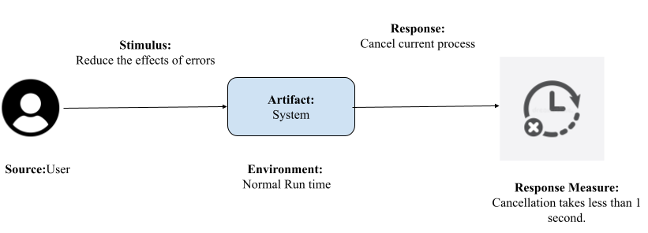
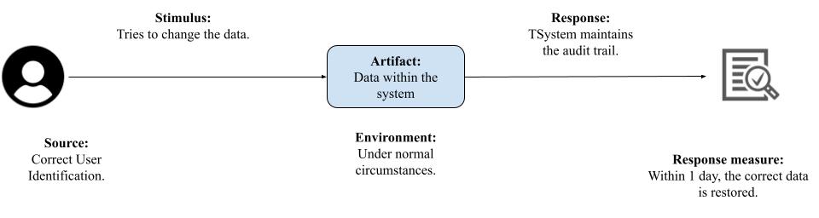
9.4. Usability Test: The user cancels the process of configuring
keyword search volumes by city that used a location filter.
Usability test diagram
This graphic represents the usability test, which examines how easily and effectively the system operates for the user.
The user wants to remove the ability to restrict keyword search volumes by city, according to the request. The work should be generated by the system in a quick and effective manner.
The cancel process must be completed in less than 1 second in order to request the procedure in less than 2 seconds and complete the task.
9.5. Security Test:
The system's request and authorization will be tested throughout this testing. Users ask the system to edit the data that is related to the database.
The system will determine if the condition is satisfied when it asks data by checking the user's authorization to alter the information.
The server will fulfill the request, respond to the user's request for data, and display the request's status.
Security Test Diagram[3].

Slide 9
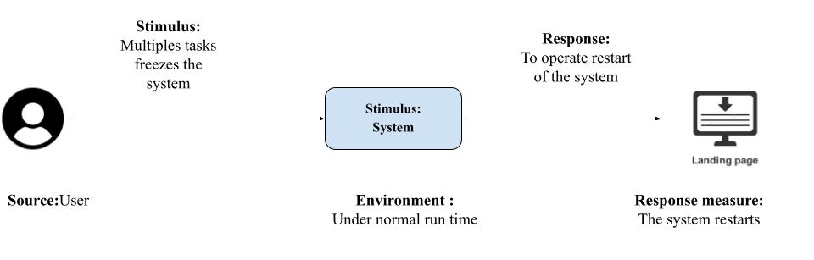
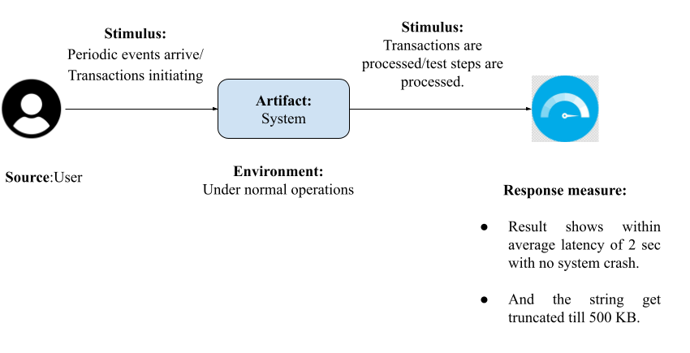
9.6. Performance Test
9.7 Availability test: Test user landing pages availability for the effectiveness of keyword research[7]:
How it operates.
Users may get a performance summary for the sites that their advertisements are delivering visitors to on the "Landing pages" page. All landing page URLs from Search, Display, Video, Search, and Shopping campaigns are included on this page.
Availability test diagram
The purpose of the availability test is to evaluate a system's failure and reusability. Here, the user is performing several activities at once, which increases the risk of a system freeze or crash. If the application doesn’t react within 10 seconds, the system will complete the task. The program will automatically restart.
Sr No. | Test Scenario | Test Steps | Expected results
1 | Open many browsers or tabs. | 1. Launch many tabs in a browser. 2. Open www.google.com in a new tab. | System failure shouldn't occur.
3 | Adding text to the search box that is longer than 500 kb. | 1. Open www.google.com in a new tab. 2. Create a string that is at least 500 KB long and paste it into the search field. 3. Press the Search key. | To 500 KB, the string should be truncated.
Performance Test Diagram for the aforementioned test scenarios, test procedures, and anticipated outcomes.

Slide 10
Conclusion
Any organization that plans to run its own Google Ads for its goods or services will find Google's Keyword Planner to be a very useful tool. It's a fantastic method for conducting keyword research and locating long-tail phrases that your Google ad campaigns may use as targets. The Google Keyword Planner tool is really helpful since it provides all the information users need to determine whether or not something will be a success before actually moving through with it. Additionally, it provides users with a decent indication of the cost of Google advertising as well as the expected volume of traffic that their keywords will receive on their search network.

